Slide 1
IBM University Engagement Project Submission
“Exploring the Power of Agentic AI with IBM Granite and LangFlow”

Slide 2

Project Tile – Agentic AI for Mental Health Awareness & Suicide Prevention
Domain of Project – Healthcare
Student Name | Recent Passport Photo | Email ID | Mobile number [WhatsApp]
Radhika Bodhe |  | radhikabodhe.tcoert@kjei.edu.in | 9867759704

Slide 3
Problem Statement -
Mental health issues such as stress, anxiety, depression, loneliness, burnout, and emotional distress are increasing across students, professionals, and communities worldwide. Despite the growing need for support, many individuals remain unaware of mental health resources, hesitate to seek help due to stigma, or fail to recognize early warning signs of psychological distress. Limited access to timely guidance and professional support can lead to worsening mental health conditions and, in severe cases, increase the risk of self-harm or suicide.
The challenge is to develop an Agentic AI-powered mental health support system that can proactively engage users, promote mental health awareness, detect signs of emotional distress through conversations and behavioral patterns (with user consent), and provide personalized wellness recommendations. The system should intelligently assess risk levels, encourage healthy coping strategies, and safely guide users toward trusted support networks, mental health professionals, crisis helplines, or emergency services when required.
The solution must leverage a multi-agent AI architecture capable of education, emotional analysis, recommendation generation, follow-up engagement, and crisis intervention while ensuring privacy, transparency, security, and ethical AI practices. The ultimate goal is to create an accessible, trustworthy, and scalable digital companion that supports early intervention, reduces stigma around mental health, improves awareness, and contributes to suicide prevention efforts.

Slide 4
Technology Used
Core IBM Technologies
1. IBM watsonx Orchestrate
Role: Central Agent Orchestration Platform
Coordinates multiple AI agents.
Manages workflows and task execution.
Routes user requests to appropriate agents.
Automates follow-up actions and wellness check-ins.
Enables collaboration between Awareness, Emotion Detection, Recommendation, and Crisis Response agents.
2. IBM watsonx.ai
Role: Foundation Model & AI Engine
Natural Language Understanding.
Conversational AI.
Sentiment and emotion analysis.
Personalized response generation.
Retrieval-Augmented Generation (RAG).
3. IBM watsonx.data
Role: Knowledge Repository
Stores mental health resources.
Maintains wellness content.
Stores FAQ databases.
Supports semantic search and retrieval.
4. IBM Cloud
Role: Cloud Infrastructure
Application hosting.
Secure data storage.
Authentication and access control.
Monitoring and scalability.

Slide 5
Proposed Solution -
The proposed solution is an Agentic AI-powered Mental Health Awareness and Suicide Prevention platform built using IBM watsonx Orchestrate as the central orchestration layer. The system leverages multiple specialized AI agents that collaborate to provide mental health education, emotional well-being support, personalized wellness recommendations, and crisis intervention assistance. Users can interact with the platform through a web or mobile interface to discuss their concerns, track their emotional health, access educational resources, and receive guidance tailored to their needs. The Emotion Analysis Agent continuously analyzes user interactions to identify signs of stress, anxiety, depression, or emotional distress, while the Risk Assessment Agent evaluates the severity of the situation. Based on this analysis, the Wellness Recommendation Agent suggests coping strategies such as mindfulness exercises, breathing techniques, journaling activities, sleep improvement practices, and healthy lifestyle habits. The Mental Health Awareness Agent delivers reliable information and awareness content to reduce stigma and improve understanding of mental health issues. In situations where elevated risk is detected, the Crisis Intervention Agent provides immediate support by directing users to trusted adults, mental health professionals, helplines, or emergency services. A Follow-up Agent proactively conducts wellness check-ins and monitors progress over time to encourage sustained engagement and early intervention. By combining AI-driven emotional intelligence, trusted mental health knowledge, workflow automation, and ethical AI principles, the proposed solution aims to create an accessible, scalable, and proactive digital companion that promotes mental well-being, facilitates early detection of emotional distress, and contributes to suicide prevention.

Slide 6
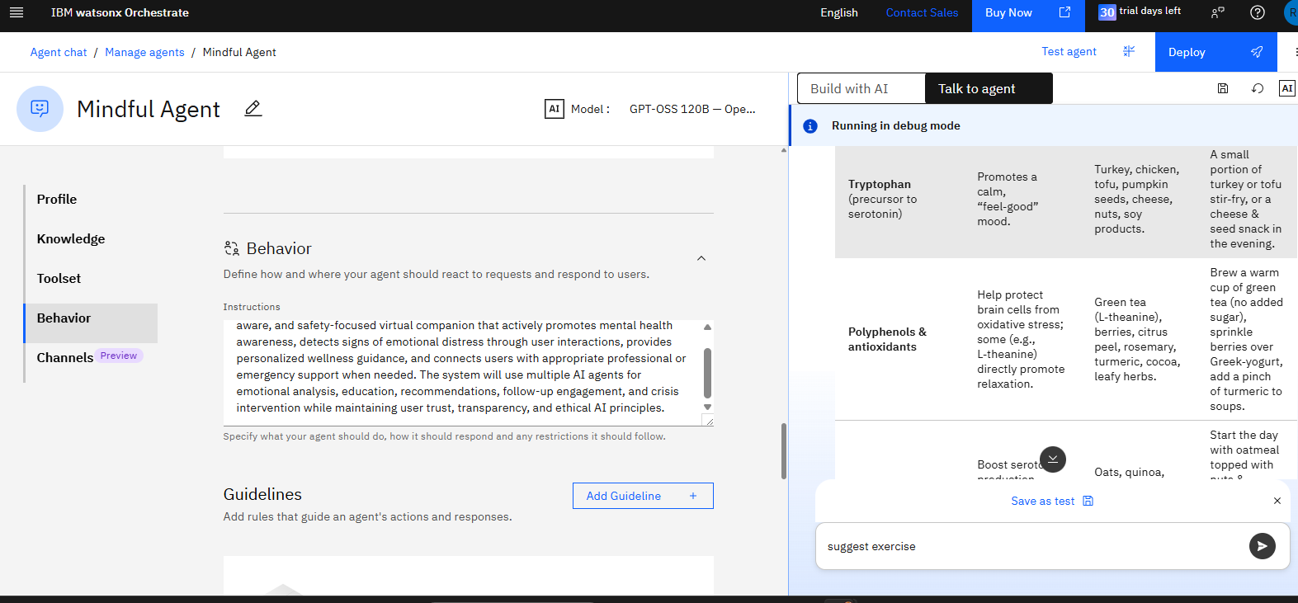

Slide 7
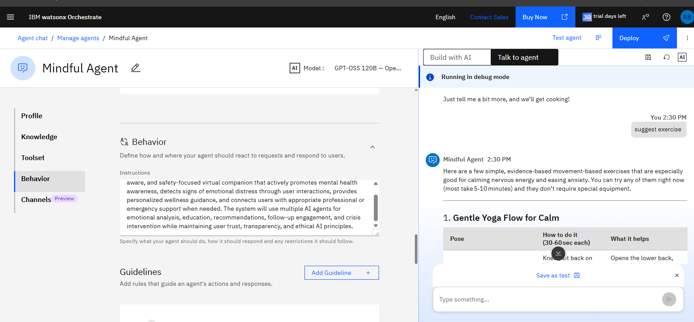

Slide 8
Component Used -
Knowledge Based
File component - Stores and retrieves user data, meal logs, and nutritional datasets for analysis and tracking.
Agentic AI for Mental Health Awareness & Suicide Prevention project, the File Component is used to generate and manage PDF reports that summarize a user's mental wellness journey and AI-assisted support activities. The component collects information from different AI agents, including emotional analysis results, mood tracking data, wellness recommendations, awareness resources accessed, and follow-up activities. Using IBM Watsonx Orchestrate, the system compiles this information into a well-structured PDF document that users can download for personal reference.
The generated PDF may include the user's emotional wellness summary, detected stress or anxiety trends, recommended coping strategies, daily wellness goals, completed activities, and mental health educational content. For users who consent, the report can also be shared with counselors, healthcare professionals, or family members to support informed decision-making and continuity of care. The File Component ensures secure document generation, protects user privacy, and provides a convenient way to maintain records of mental health progress. By transforming AI-generated insights into a professional report, this component enhances user engagement, tracking, and long-term mental wellness management.

Slide 9

Architecture blueprint

Slide 10

Role of Agentic AI in the solution
Agentic AI serves as the core intelligence of the Mental Health Awareness & Suicide Prevention platform by enabling multiple specialized AI agents to work collaboratively and autonomously. Unlike traditional chatbots that simply respond to user queries, Agentic AI can understand user needs, make decisions, coordinate tasks, and proactively take appropriate actions. In this project, Agentic AI continuously monitors user interactions to identify emotional distress, assess mental well-being, provide personalized recommendations, and determine when additional support may be required.
Using IBM Watsonx Orchestrate, the system coordinates various agents such as the Mental Health Awareness Agent, Emotion Analysis Agent, Wellness Recommendation Agent, Risk Assessment Agent, Crisis Intervention Agent, and Follow-up Agent. Each agent performs a specific task while sharing information with other agents to deliver a comprehensive and personalized user experience. For example, when a user expresses stress or anxiety, the Emotion Analysis Agent detects the emotional state, the Risk Assessment Agent evaluates the severity, the Wellness Recommendation Agent suggests coping strategies, and the Follow-up Agent schedules future wellness check-ins. If a potentially critical situation is identified, the Crisis Intervention Agent provides appropriate support resources and encourages contact with trusted people or professional services.
By automating decision-making, personalizing support, enabling proactive engagement, and coordinating multiple AI capabilities, Agentic AI transforms the platform into an intelligent digital companion that promotes mental health awareness, supports early intervention, and helps users access appropriate resources in a timely and ethical manner. This makes the solution more effective, scalable, and responsive than conventional rule-based systems.

Slide 11
Technology Used
IBM Grainte model - for eg – ibm-granite-3-2-8b – For natural language understanding, reasoning, and personalization
IBM Cloud – It provides the infrastructure to build, deploy, and scale the Nutrition Agent efficiently. IBM Cloud enables a reliable, secure, and scalable environment for deploying the Nutrition Agent.
RAG– RAG to fetch real data first, then generate intelligent answers, making the Nutrition Agent more trustworthy and effective.
IBM Watsonx.ai - For model deployment, embeddings, and AI governance
IBM Watsonx Orchestrate

Slide 12
Novelty and Uniqueness
The novelty of this project lies in its use of Agentic AI to provide proactive, personalized, and continuous mental health support rather than functioning as a traditional question-answer chatbot. Unlike conventional mental health applications that only respond when users actively seek help, our solution employs multiple intelligent agents working collaboratively through IBM watsonx Orchestrate to understand emotional states, assess risks, deliver tailored wellness recommendations, and initiate follow-up interactions. This creates a more dynamic and human-centric support system capable of adapting to each user's emotional needs.
A key unique feature is the multi-agent architecture, where specialized agents handle awareness, emotion detection, risk assessment, wellness planning, crisis intervention, and follow-up monitoring. These agents communicate and coordinate autonomously to provide comprehensive support rather than relying on a single AI model. The system also combines mental health education, emotional analysis, personalized self-care guidance, and crisis support within one integrated platform. Another innovative aspect is the generation of wellness reports and progress summaries that help users track their mental well-being over time. By leveraging AI-driven emotional intelligence, proactive engagement, ethical decision-making, and automated orchestration, the proposed solution offers an accessible, scalable, and preventive approach to mental health awareness and suicide prevention, making it significantly different from existing chatbot-based mental health tools.

Slide 13
Git Hub Link
· Please create public github repository (Enable Add README button while creating repository) with format –
Please test and Paste the working Github URL –
Make sure you have Uploaded following three files into your github repository 1) app.json file , 2) yourproblemstatement.pdf file 3) your projectpresntation.pptx file 4)any other files
·
·
·

Slide 14
Future Scope
The proposed Agentic AI for Mental Health Awareness & Suicide Prevention platform can be expanded in several ways to enhance its effectiveness and reach. Future versions of the system can incorporate voice-based emotion recognition to analyze speech patterns, tone, and sentiment for more accurate emotional assessment. Integration with wearable devices and smartwatches can enable real-time monitoring of health indicators such as sleep quality, heart rate, physical activity, and stress levels, allowing the AI agents to provide more personalized wellness recommendations.
The platform can also be extended with multilingual support to serve users from diverse linguistic backgrounds and improve accessibility. Advanced predictive analytics and machine learning models can be developed to identify long-term mental health trends and provide early warnings for potential emotional crises. Integration with telemedicine platforms and mental health professionals can facilitate seamless referrals and virtual counseling sessions. Additionally, community support features, peer-support networks, and AI-powered group wellness programs can be introduced to foster social connection and reduce feelings of isolation. With continuous learning and enhancement, the system has the potential to evolve into a comprehensive digital mental health ecosystem that supports prevention, awareness, intervention, and long-term emotional well-being on a larger scale.
·
·
·

Slide 15


